Slide 1
Human Computer Interaction
The Computer
Lecture 2B
Imran Siddiqi
imran.siddiqi@gmail.com

Slide 2
Contents
Introduction
Text Entry Devices
Positioning, Pointing & Drawing
Display Devices
Physical Controls, Sensors & Special Devices
Paper: Printing & Scanning
The Computer

Slide 3
Display Devices
Bitmap Screens
  CRT & LCD
Large and Situated Displays
Digital Paper
The Computer

Slide 4
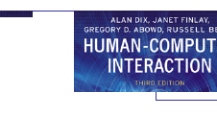


Bitmap Displays
Screen: Vast number of color dots
The Computer

Slide 5
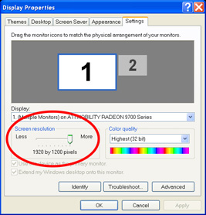
Resolution
Resolution … used (inconsistently) for
  Number of pixels on screen (width x height)
    e.g. 1024x768 pixels
  Density of pixels (in pixels or dots per inch - dpi)
    Typically between 72 and 96 dpi
Aspect ratio
  Ration between width and height
  4:3 for most screens, 16:9 for wide-screen TV
The Computer

Slide 6
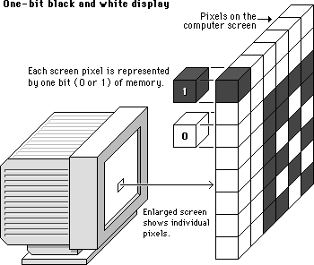
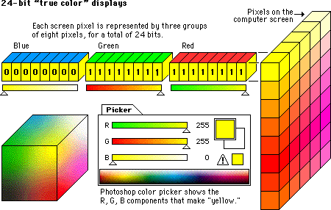
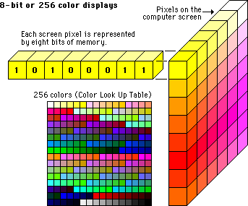
Color Depth
How many different colours for each pixel?
One bit per pixel – On/Off
8 bits per pixel – 256(2⁸) Colours
8 bits for each red, blue, green
  Millions of colours
The Computer

Slide 7
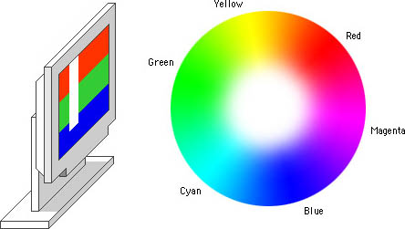
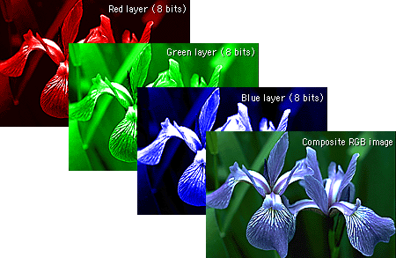
Color Depth
The Computer

Slide 8
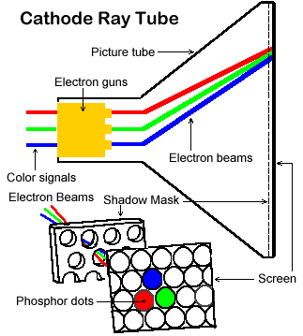
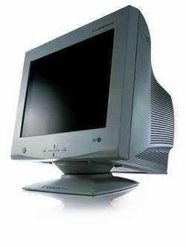
Technologies
Cathode Ray Tube
  Television Screens & Computer Monitors
  Stream of electrons emitted from electron gun, focused and directed by magnetic fields, hit phosphor-coated screen which glows
The Computer

Slide 9
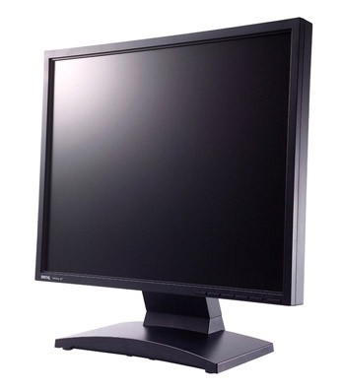
Technologies
Liquid Crystal Display (LCD)
  PDAs, Notebooks etc.
    Increasingly for desktop and home tv
  Smaller and lighter
  Layer of liquid crystal b/w two glass plates
The Computer

Slide 10
Large Displays
Used for meetings, lectures etc.
Technology
  Plasma – Usually wide screen
  Video Wall – Several small screens
  Video Projectors
The Computer

Slide 11
Situated Displays
Displays in public places
Display only
  Information relevant to the location
Interactive
  May use stylus, touch sensitive screen
In All Cases
  Meaning of information or interaction is related to the location
The Computer

Slide 12
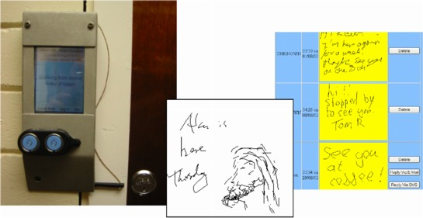
Hermes – A situated display
small displays beside office doors
handwritten notes left using stylus
office owner reads notes using web interface
Small displays
beside
office doors
Handwritten
notes left
using stylus
Office owner
reads notes
using web interface
The Computer

Slide 13
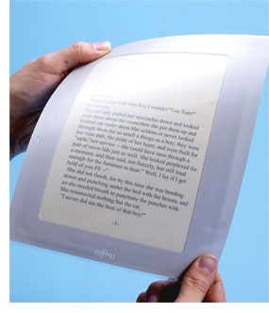
Digital Paper
Thin and flexible – Electronically written
Keep contents when removed from electric supply
Uses?
  Banners – Updates are not frequent
  ‘Soft’ Book
The Computer

Slide 14
Contents
Introduction
Text Entry Devices
Positioning, Pointing & Drawing
Display Devices
Physical Controls, Sensors & Special Devices
Paper: Printing & Scanning
The Computer

Slide 15
Physical Controls, Sensors & Special Devices
Dedicated Displays
Sound Output
Touch, Feel & Smell
Physical Control
Environment & Bio-sensing
The Computer

Slide 16
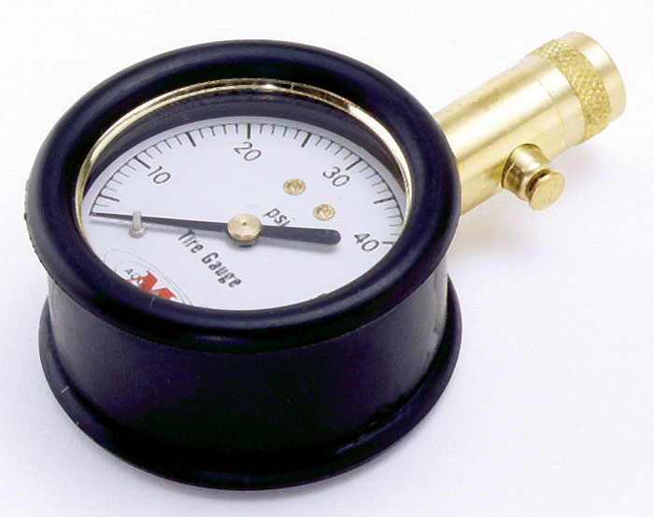
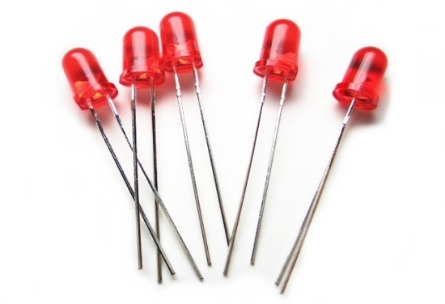
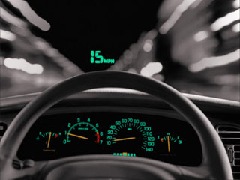
Dedicated Displays
Process state and control
Analogue Representation
  Dial gauges
Digital Displays
  LEDs
Head-up Displays
  Presents the most important information
  No need to look away from his or her usual viewpoint
  Cockpits - Cars
The Computer

Slide 17
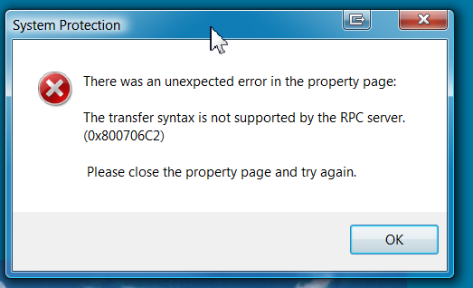
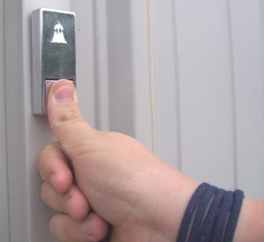
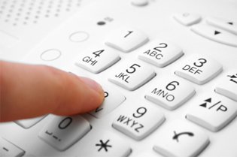
Sound Output
Beep, Buzz, Whistle …
Auditory Signals – Feedback in Interactive Systems
  Door bell
Indication of Error
Confirmation of Action
  Telephone key press
The Computer

Slide 18
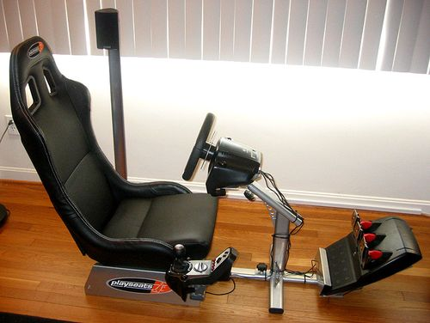
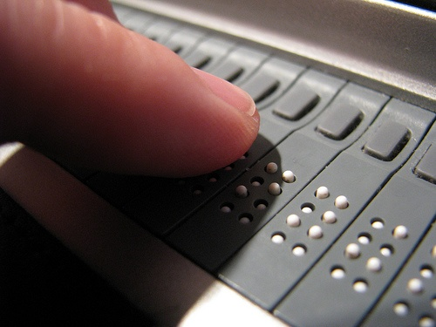
Touch, Feel & Smell
Touch
  Haptic Devices - Take advantage of our sense of touch by applying forces/vibrations
  Games – Vibration of joystick/steering wheel
  Electronic Braille – Pins rise and fall
Texture, Smell, Taste
  Very limited technology
The Computer

Slide 19
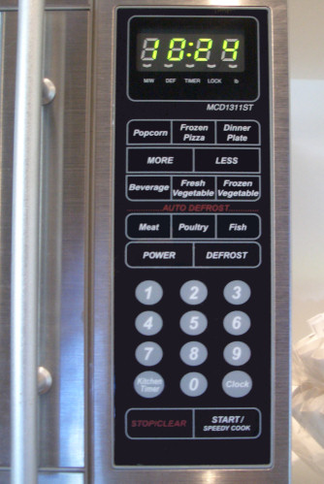
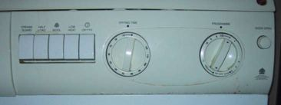
Physical Controls
Specialized Controls
  Consumer Products
Easy-clean
smooth buttons
Large buttons
Clear dials (Control+Display)
The Computer

Slide 20
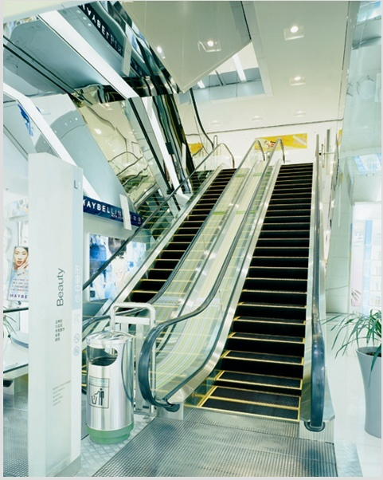
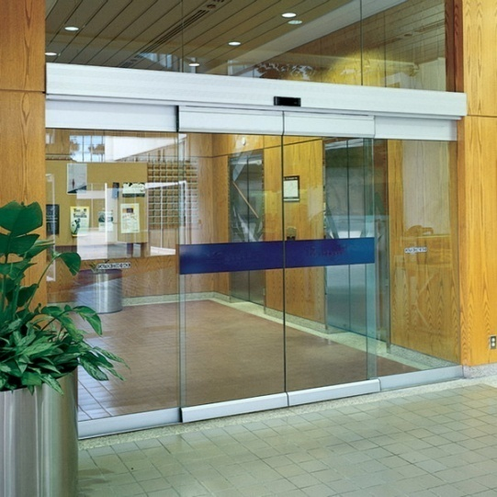
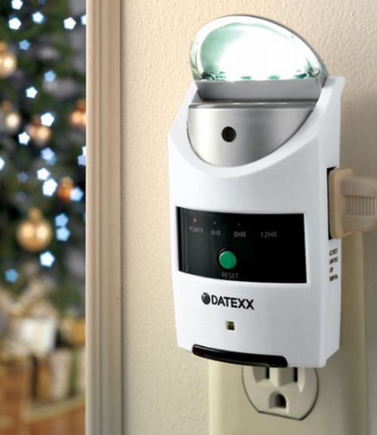
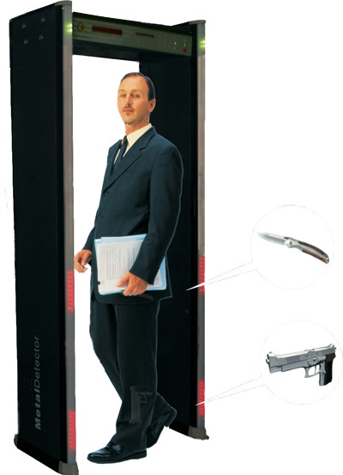
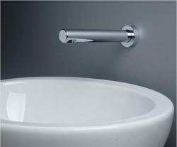
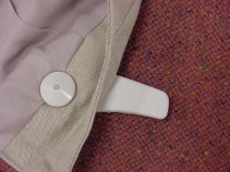
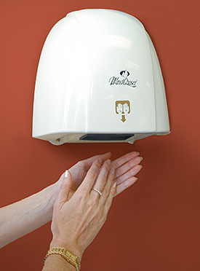
Environment & Bio-Sensing
Sensors all around us
The Computer

Slide 21
Contents
Introduction
Text Entry Devices
Positioning, Pointing & Drawing
Display Devices
Physical Controls, Sensors & Special Devices
Paper: Printing & Scanning
The Computer

Slide 22
Paper: Printing & Scanning
Paperless Office
  Produce, Dispatch and Read documents online
  Complete paperless – No more a goal
    Less-Paper Office
Printing
  Electronic Media – Paper
Scanning
  Paper – Electronic Media
The Computer

Slide 23
Printing
Image on the Paper – Series of Dots
Types of Printers
  Dot-matrix, Ink-jet, Laser jet
Critical Features
  Resolution - DPI
  Speed – Pages/Characters per minute
  Cost
The Computer

Slide 24



Types of Printers
The Computer

Slide 25
Fonts
Font – The particular style of text
Size of a font measured in points (1 pt about 1/72”) (vaguely) related to its height
Courier font
Times Roman font
This is fourteen point
This is eighteen point
The Computer

Slide 26


Fonts
Pitch
  Fixed-pitch – every character has the same width e.g. Courier
  Variable-pitched – some characters wider e.g. Times Roman – compare the ‘i’ and the “m”
Serif or Sans-serif
  Sans-serif – square-ended strokes e.g. Calibri
  Serif – with splayed ends (such as) e.g. Times Roman
The Computer

Slide 27
Page Description Languages
Pages very complex
  Different fonts, bitmaps, lines, digitised photos, etc.
Can convert it all into a bitmap and send to the printer
  … but often huge !
Alternatively Use a page description language
  Sends a description of the page
  Instructions for curves, lines, text in different styles, etc.
  Like a programming language for printing!
PostScript is the most common
The Computer

Slide 28
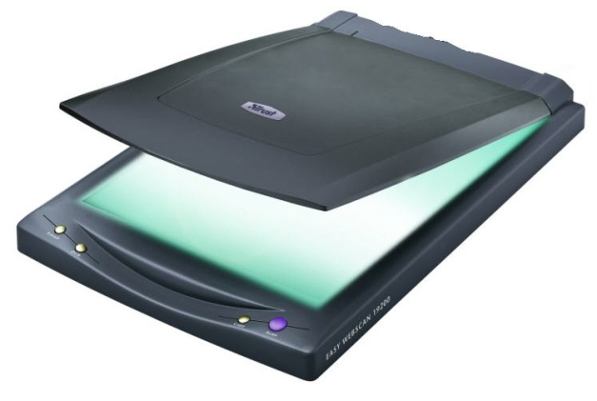
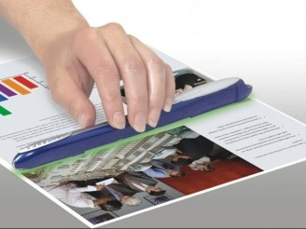
Scanners
Takes paper and converts it into a bitmap
Two sorts of scanner
  Flat-bed: Paper placed on a glass plate, whole page converted into bitmap
  Hand-held: Scanner passed over paper, digitizing strip typically 3-4” wide
Useful in Document storage and retrieval systems, doing away with paper storage
The Computer

Slide 29
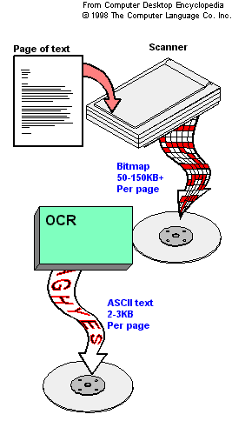
Scanners & OCR
OCR – Optical Character Recognition
OCR converts bitmap back into text
More useful, Space Efficient
Challenges
  Font Variation
  Text Segmentation
The Computer

Slide 30

References
Chapter 2: Human Computer Interaction by Dix et al.
User Interface Hall of Fame/Shame
The Computer

